Slide 1
Purpose & Personality
What Makes Us Who We Are?

Slide 2
LET’S DISCUSS- 1. People Need Jesus 2. Purpose 3. Personality 4. The What, Why, Who & How 5. 7 Cultural Mountains 6. You, Bethel & The Strategic Plan

Slide 3
I believe:
The bible is the inspired word of God
Everything in it is for today, possible & my daily roadmap
We serve a limitless God!
God always has & wants His best for us
God is the God of impossible
Notes:
A quick introduction of Team 2 and then discuss what we all will be talking about in the presentation.
19 Characteristics of High Performance
10 Keys to Productivity

Slide 4
I have a divine purpose
I am ready to release what I need to release
I am ready to receive what I need to receive
I choose to take all limits off God today!
Matthew 19:26 Jesus looked at them and said, “With man this is impossible, but with God all things are possible.” NIV
Notes:
A quick introduction of Team 2 and then discuss what we all will be talking about in the presentation.
19 Characteristics of High Performance
10 Keys to Productivity

Slide 5
James 2:14 What good is it, my brothers and sisters, if someone claims to have faith but has no deeds? Can such faith save them?
“If you spend too much time thinking about a thing, you’ll never get it done.” ~ Bruce Lee
We need a plan of action then walk it out…
Notes:
A quick introduction of Team 2 and then discuss what we all will be talking about in the presentation.
19 Characteristics of High Performance
10 Keys to Productivity

Slide 6
Go w/ me to 2000… Met w/ a purpose coach, took DISC, changed our lives forever- became pastors, got doctorate in ministry & leadership & now we lead, teach, empower & disciple others in purpose & spiritual freedom internationally

Slide 7
The What- Let’s Plan
People are hungry & searching for solutions & answers
PEOPLE NEED JESUS!
Bethel Worship Center is in the People Business
God is calling us to be READY w/ HIS PLAN!

Slide 8
The What- Steps
SALVATION- GET FREE- DISCIPLESHIP- SEND THEM OUT
Matt. 28:18 Jesus came & said to them, “All authority in heaven & on earth has been given to me. Go therefore & make disciples of all nations, baptizing them in the name of the Father & of the Son & of the Holy Spirit, teaching them to observe all that I have commanded you. And behold, I am w/ you always, to the end of the age.”

Slide 9
Share God’s truth & change because the truth is worth defending! If we claim to have fellowship with him & yet walk in the darkness, we lie & do not live out the truth. 1 John 1:6

Slide 10
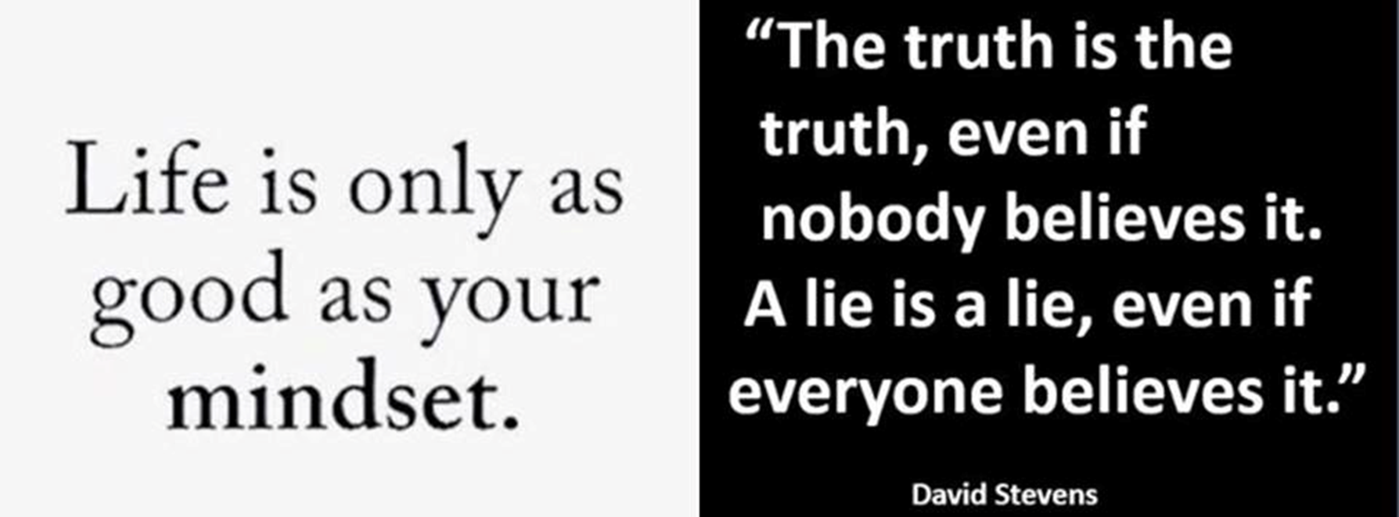
S

Slide 11
The Why- People Need Jesus So We Must Be Ready
World changes & current conditions
World versus God’s Word
Voices- Chaos/Order, Fear/Faith, Victim/Victor
Be careful what you expose yourself to- (tv, books, people, internet, music, etc.)

Slide 12
Exposure Influences Destiny & Purpose
Exposure Governs Thinking
Thinking Governs Emotions
Emotions Govern Decisions
Decisions Govern Actions
Actions Govern Destination, Destiny & Purpose

Slide 13
The Why- Freedom & Serving
Galatians 5:13 You, my brothers & sisters, were called to be free. But do not use your freedom to indulge the flesh; rather, serve one another humbly in love.
The 7 Cultural Mountains

Slide 14
the 7 Cultural Mountains
FAMILY
RELIGION & FAITH
EDUCATION
GOVERNMENT & LAW
MEDIA, NEWS & COMMENTARY
ARTS & ENTERTAINMENT
BUSINESS & ECONOMICS
Which one are you called to transform?

Slide 15
You Have Potential & Passion to Reform a Mountain As.for you, the anointing you received from him remains in you & you do not need anyone to teach you. But as his anointing teaches you about all things & as that anointing is real, not counterfeit—just as it has taught you, remain in him. 1 John 2:27
This Photo by Unknown Author is licensed under CC BY-SA

Slide 16
The Who- YOU- Bethel People
DISC Personality System-
Enables you to understand yourself better to achieve your goals & purpose w/ a growth mindset
Helps Bethel connect you w/ Kingdom needs
Shows how your preferences & thinking influences where you are most successful
Shows how you respond to your environment

Slide 17
Discover Your Purpose
PURPOSE- the reason for which something is done or created or for which something exists
You have a PURPOSE! A big idea & passion incredibly valuable for others
You have knowledge, expertise & a story/testimony
This Photo by Unknown Author is licensed under CC BY

Slide 18
Your Purpose Story
Your testimony can save a life & change a heart- not alone
Rev. 12:11 They triumphed over him by the blood of the Lamb and by the word of their testimony; they did not love their lives so much as to shrink from death.

Slide 19
Purpose
Limiting beliefs? Does it line up w/ God’s Word?
Eph. 6:12 For our struggle is not against flesh and blood, but against the rulers, against the authorities, against the powers of this dark world and against the spiritual forces of evil in the heavenly realms.

Slide 20
God’s Purpose for YOU!
Daniel 7:10 A river of fire was flowing, coming out from before him. Thousands upon thousands attended him; ten thousand times ten thousand stood before him. The court was seated, and the books were opened.
Phil. 1:6 Being confident of this, that he who began a good work in you will carry it on to completion until the day of Christ Jesus.

Slide 21
Discover Your Purpose & Place of Choice w/ TEAMS
You are equally & awesomely gifted.
Identify & appreciate the differences.
The TEAMS Profile-
T- Theorist
E- Executor
A- Analyzer
M- Manager
S- Strategist

Slide 23
Personality
Personality- the combination of characteristics or qualities that form an individual's distinctive character
People are different yet predictably so!
Are you change receptive or change resistant? Natural leader or prefer “behind the scenes”? People or task-oriented?
When I understand me then I can understand you better & communicate more effectively

Slide 24
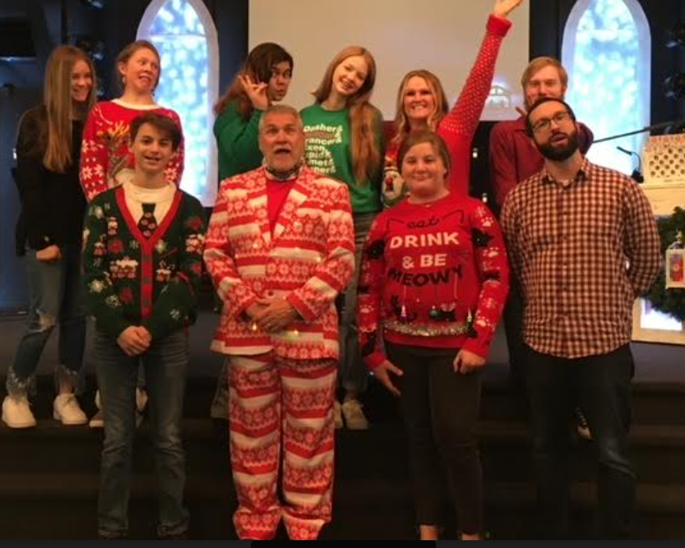
DISC Personality
Understanding behavioral styles helps you-
become a better communicator
appreciate the differences in others
positively influence those around you
DISC stands for:
Dominance Influencing Steadiness & Conscientious

Slide 25
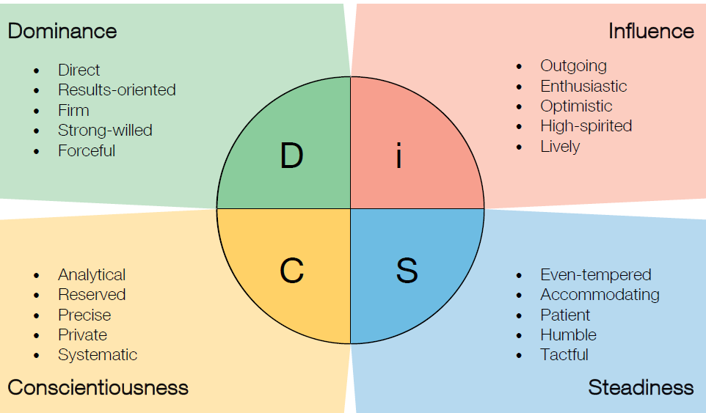
DISC Personality

Slide 26
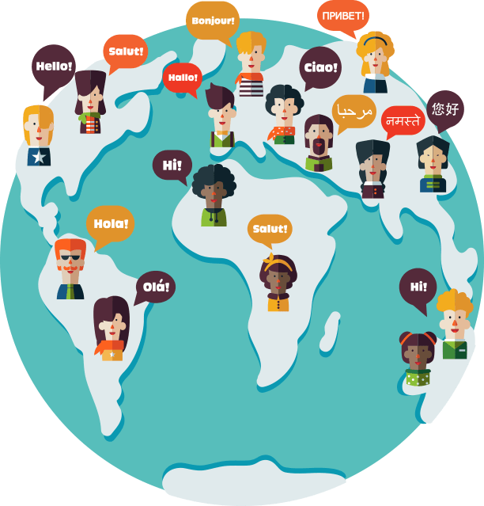
DISC Personality
The DISC Personality System is:
A universal language of behavior
A tool to bring people together around their differences & similarities
A tool for diversity awareness &
Concentrates on positive strengths
Helps reduce misunderstandings to resolve conflicts
Helps realize purpose & right placement of interest

Slide 27
You can operate in highest level of your passion
Ensures tasks best fit personality style & strengths to fully use potential
High “C” personality styles strong in planning, systems, orchestration
High “S”- valuable at listening, teamwork, follow-through
High “I”- are great at persuading, enthusiasm, entertaining
High “D”- have administration, leadership, determination

Slide 28
Equipping & Investing in YOU!
Pastors Earl & Janine & Bethel believe in YOU!
What are YOU worth? A soul worth?
Want to equip & partner w/ you to discover purpose & place for our future
Bethel investing $20 & you invest $20- Cost of one meal- Research shows…..

Slide 29
The How & The Process
Put your info- Name, Phone, Email & Payment type on the clipboard form
You will receive an invitation email from Dr. Sheila Hunt to complete the DISC & TEAMS profiles through People Keys

Slide 30
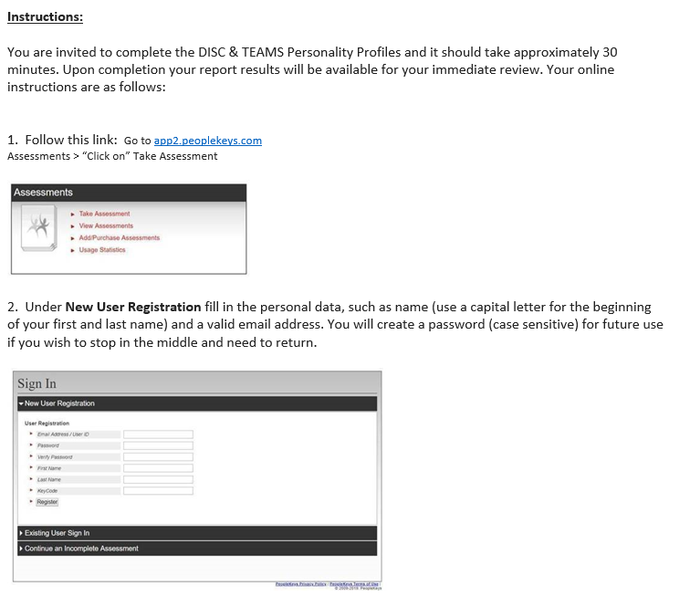
The Invitation to Participate

Slide 31
The Process- The How
Complete your DISC & TEAMS Profiles within 10 days- 24 questions- approx. 20-30 mins.
Your personal report will be sent to you upon completion
Group debrief of personality styles and area of interest for Bethel Team- Mark calendar- Wednesday, May 12th 6pm OR Sunday, May 16th at 5:30 pm.

Slide 32
Whether you have never heard of DISC & TEAMS personality profiles, taken something like it, or are a behavior analyst like me we’re all called to know our purpose, lead people to Jesus, help them get free & disciple them. Freedom starts w/ having Jesus in your heart. Father God, forgive me for what I’ve done wrong. Jesus, come into my heart, take my life and make it all you want it to be & fill me w/ your Holy Spirit.

Slide 33
Action Plan…
Look at volunteer opportunities at Bethel
Preparing for ministries, harvest & training- Tommy Barnett & Dream Center
What purpose, cultural mountain & place are you called to?
Purpose classes
Strategic Planning & Committees

Slide 34
Information becomes revelation leading to transformation & reformation

Slide 35
QUESTIONS?
THANK YOU FOR BEING AN ACTIVE PART OF TEAM BETHEL!
T- Together
E- Everyone
A- Achieves
M- More

Slide 36
Ten Keys to a Productive & High Performing Team
Goals
Roles
Interdependence
Leadership
Communication & feedback
Discussion
Decision-making & planning
Implementation & evaluation
Norms & individual differences
Structure
Cooperation & conflict management

